Slide 1
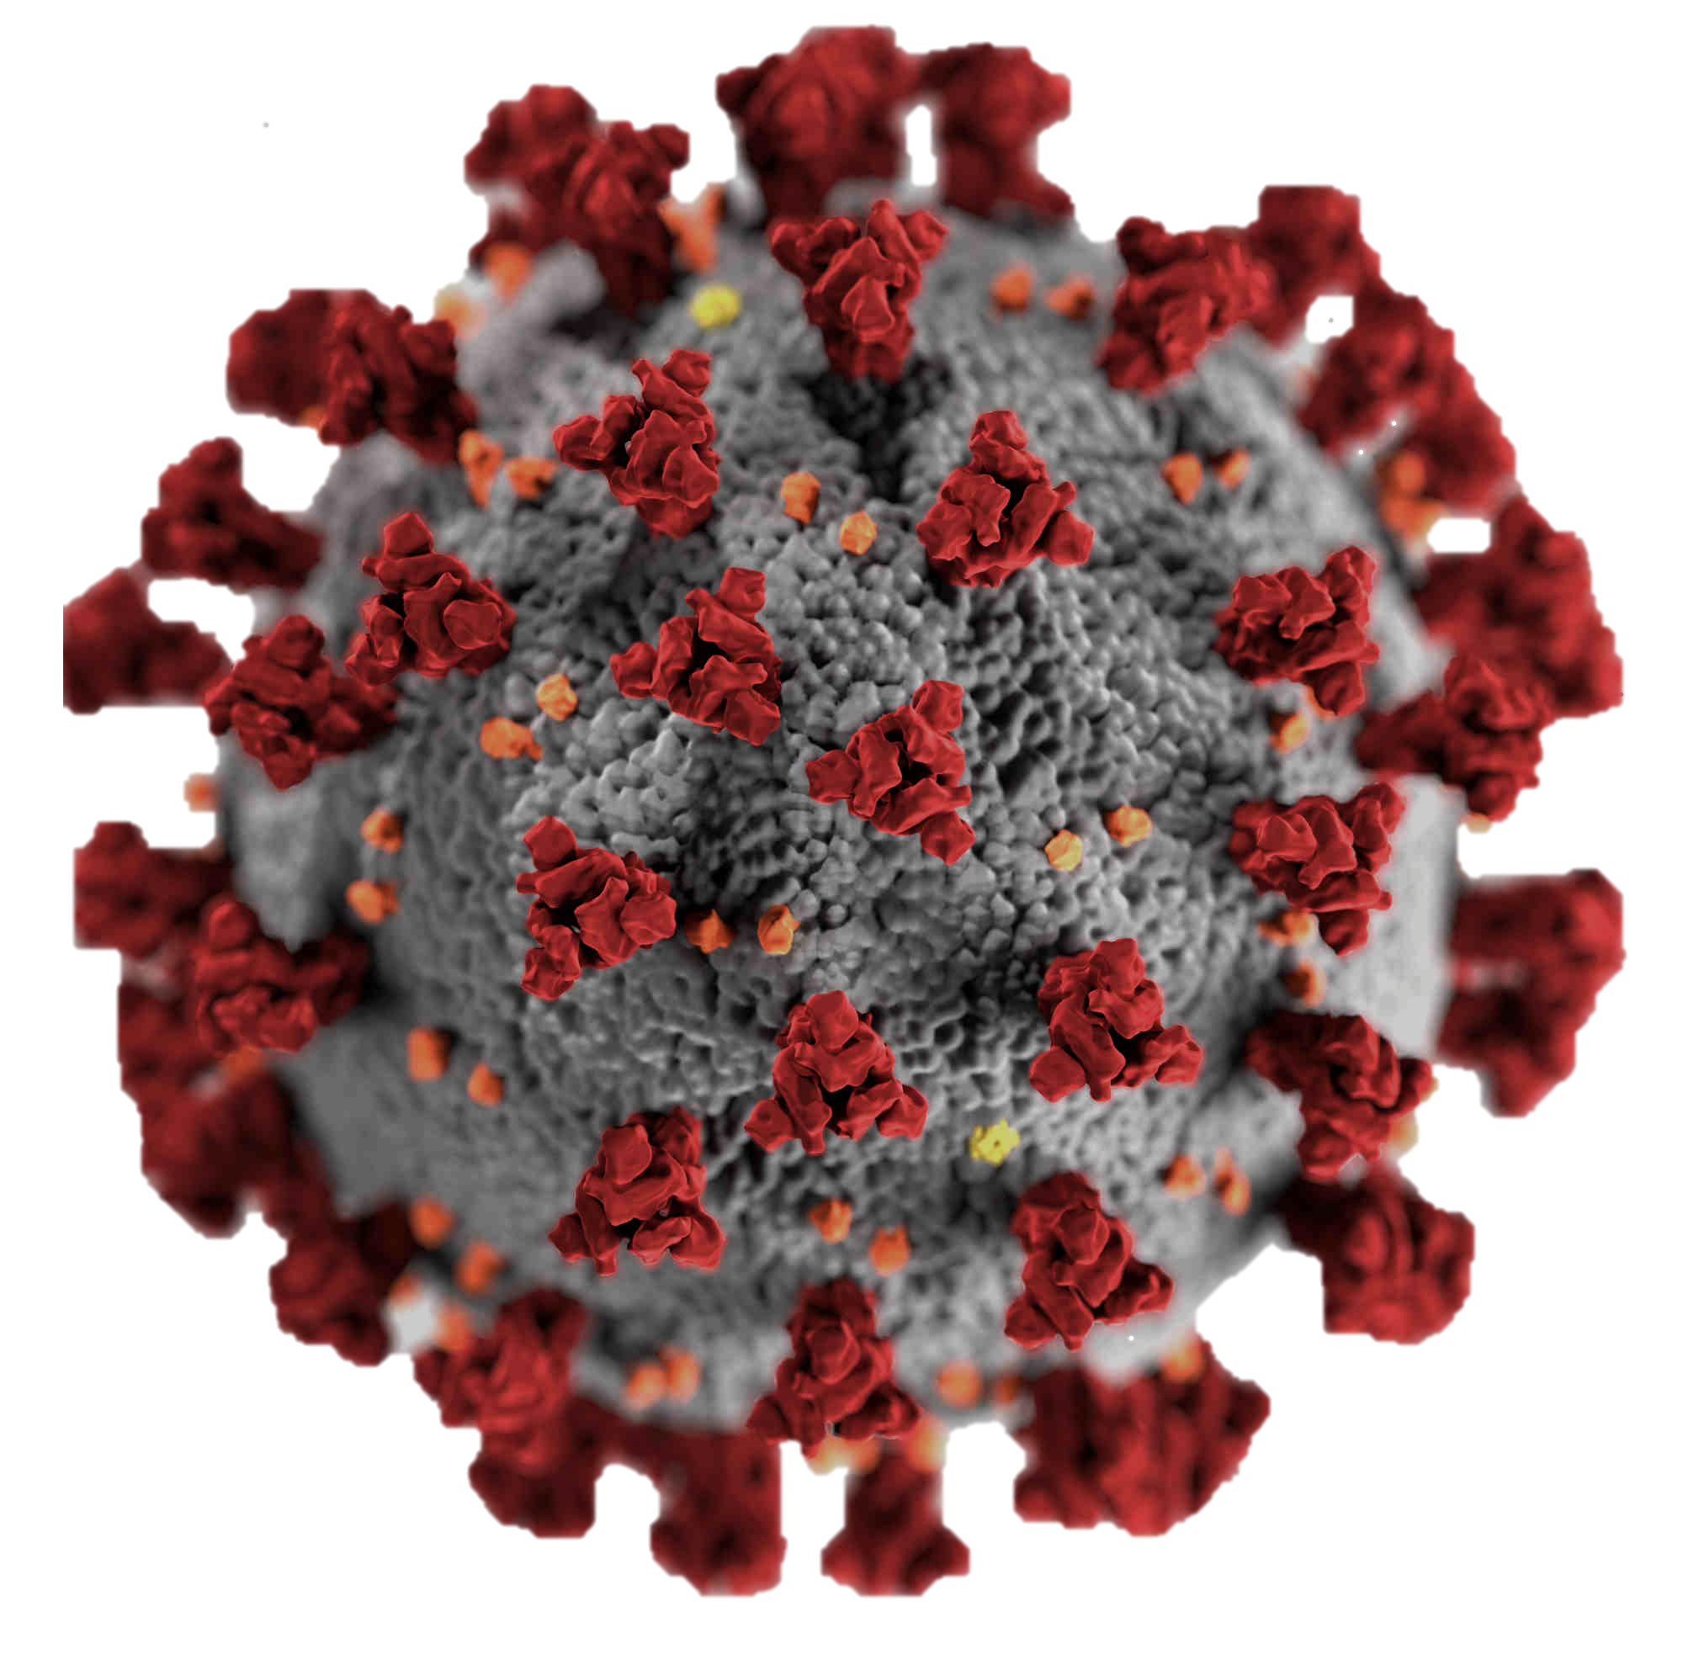
AN ANALYSIS OF GLOBAL COVID-19 DATA
Michael Owusu Agyebeng​
This Photo by Unknown Author is licensed under CC BY

Slide 2
Agenda
1
2
3
4
5
Introduction
Assessing the data
Data Cleaning
Analysis
Conclusions

Slide 3

INTRODUCTION
Recent years saw an uprising in the spread of Covid-19 virus around the world with many lives being lost to it. This study will help us identify the confirmed cases and also the death and recovery cases on a global scale from January 2018 to September 2022.

Slide 4

ASSESSING THE DATA
I collated data from three(3) data sets which are the confirmed data, death data and recovery data sets which were collected across the globe by Johns Hopkins University.
It contains time data with respect to the date they were taken and country as well.

Slide 5

DATA CLEANING
I cleaned the data using power query and merged all three (3) into one file and loaded it into MS Excel worksheet as a table.
This Photo by Unknown Author is licensed under CC BY

Slide 6

DATA ANALYSIS
Pivot tables were created and Pivot Charts were used to visualize the data.
Overall, there were a lot of duplicated results which came up as a result of the data entry process so in analyzing the data, we had to use the maximum cases of each country to determine the actual results.

Slide 7
CONFIRMED CASES
The US had the highest confirmed cases with more than twice the number in the succeeding country, India
2022 gave the most confirmed cases giving double the number we saw in 2020

Slide 8
DEATHS
Similarly, the US has the maximum deaths with Brazil as its succeeding country
The most deaths were recorded in 2021 making a total of 475,061 lives lost

Slide 9
RECOVERED
India has the maximum recovered cases with Brazil as its succeeding country whiles the rest of the countries had relatively fewer recoveries
The most recovered were recorded in 2021 but there were no recording of recoveries in 2022 so there was not enough to show but we can see a improvement of the recoveries from 2020

Slide 10

It is evident from the analysis that confirmed covid-19 related cases are real and still on the rise hence we should be careful in our activities

